Slide 1
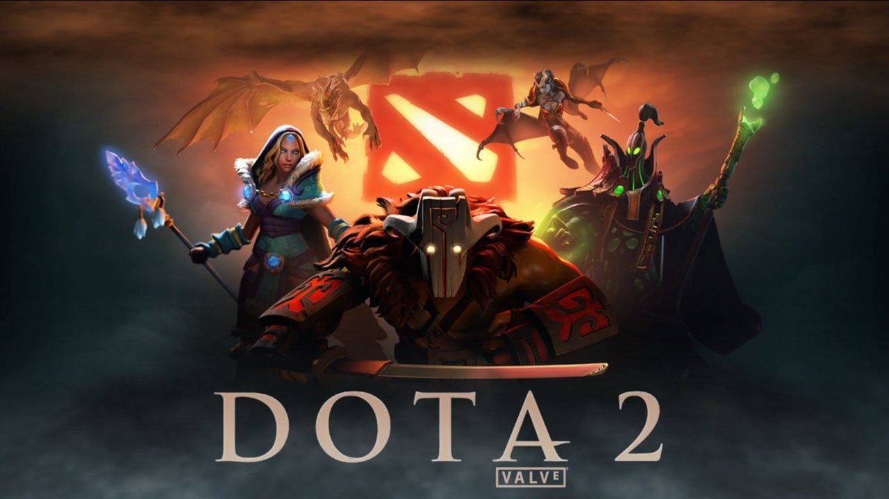
Sentiment Analysis of Dota 2 video game chat in context of Cyber-bullying
Supervisor : Noel Cosgrave
Student Details:
Aditya Kumar Singh
x20140410
Thesis Project
Notes:
Hello, my name is Aditya Kumar Singh, and this video is about my thesis. The topic of Research is Sentiment Analysis of dota 2 video game chat in context of cyberbullying.

Slide 2
Research Question
The research question of this research is to determine the effectiveness of sentiment analysis in DOTA 2 videogame and how it can be used to identify cyberbullying after incorporating specific word and nuances common to the game.
Notes:
The research question of the proposal is to find the effectiveness of Sentiment Analysis techniques in online gaming and how they can be used to combat cyberbullying. The whole process will be implemented on a dataset which is publicly available on internet. The VADER sentiment analyzer will be used as a preliminary test to obtain standard result. After Then a lexicon-based approach with an updated dictionary in line with words specific to DOTA 2 will be implemented.

Slide 3
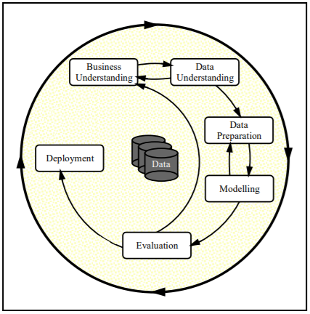
Research Methodology
Notes:
Taking note of various literature regarding sentiment analysis topic CRISP-DM methodology is chosen for this project.

Slide 4
Sentimental Analysis What and Why?
Opinion Mining of Text
Mostly used in Social Media and Customer Product Review
Notes:
Sentiment analysis (or opinion mining) is a natural language processing (NLP) technique used to determine whether a text data is positive, negative or neutral. Sentiment analysis is often performed to help businesses monitor brand and product sentiment in customer feedback, and understand customer needs. Since customers express their thoughts and feelings more openly than ever before, sentiment analysis is becoming an essential tool to monitor and understand that sentiment.
Automatically analyzing customer feedback, such as opinions in survey responses and social media conversations, allows brands to learn what makes customers happy or frustrated, so that they can tailor products and services to meet their customers’ needs.

Slide 5
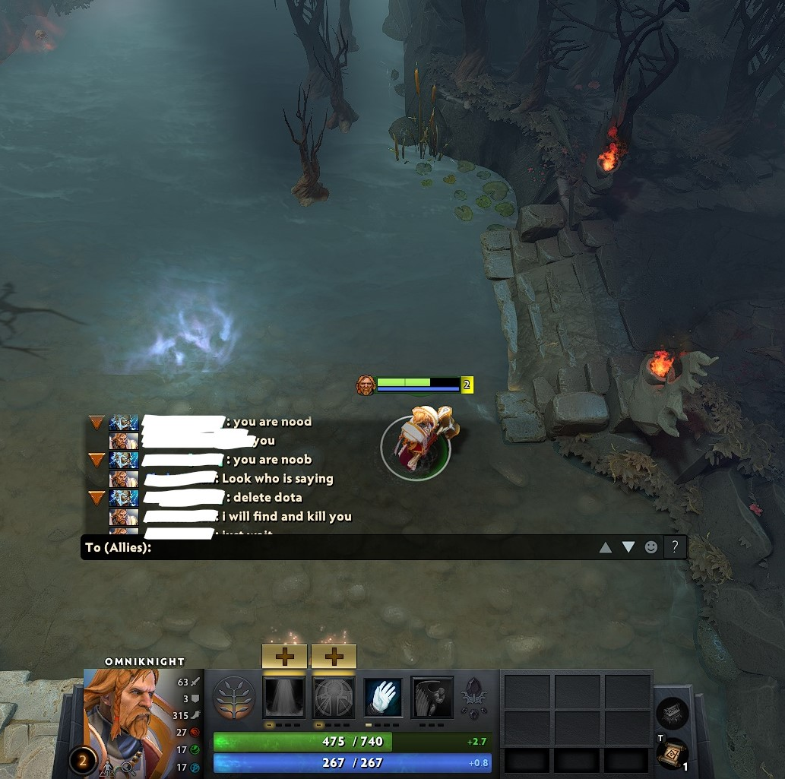
Sentiment Analysis in Online videogames
WHY?
Cyberbullying
Notes:
Playing videogames can positively impact a players’ cognitive, emotional, and social skills. It can also help children and teens enhance their problem-solving and strategizing skills. Multi-player team games may help youth learn how to cooperate with others. While gaming has the potential for positive benefits, it is also a place where cyberbullying can happen. If someone is not performing well in a game, other players may curse or make negative remarks that can turn into bullying, or even exclude the person from playing together.
Anonymity of players and the use of avatars allow users to create alter-egos or fictional versions of themselves, which is part of the fun of gaming. But it also allows users to harass, bully, and sometimes gang up on other players.
From a business point of view, A gamer who experiences a great time is more likely to invest more within the entertainment source, hence the sentiment analysis may become a important tool for videogame developers in terms of following players’ feelings and common toxic traits.

Slide 6
Sentiment Analysis techniques
Rule-Based Approach
Learning-Based Approach
Notes:
There are various approaches to sentiment analysis. This is a practical approach to analyzing text without training or using machine learning models. The result of this approach is a set of rules based on which the text is labeled as positive/negative/neutral. These rules are also known as lexicons. Hence, the Rule-based approach is called Lexicon based approach.
Widely used lexicon-based approaches are TextBlob, VADER, SentiWordNet.
Another approach is using a tool that analyzes texts for polarity, from positive to negative. By training machine learning tools with examples of emotions in text, machines automatically learn how to detect sentiment without human input.

Slide 7
Technique Chosen for this research
Rule-based approach better for unsupervised learning
Easily modified and understood
Easy to generate sentiment data for specific field
AND
WHY?
Notes:
When there is no data to begin with like in this case in Machine Learning, there is a need of rule based approaches.
Incorporating Domain Knowledge: Rule based algorithms come in handy even when data is available.
Beside this there are many inherent advantages of rule based approach like
Training data is not required and High precision
One of the important point about this approach is that it Can be a good way to collect data as one can start the system with rules and let data come by naturally as people use the system.
Disadvantages of rule based approaches
Lower recall
Difficult and tedious to list all the rules

Slide 8
Comparative Model : VADER
Decode the meaning of a content that incorporates emoticons, slang, conjunctions, capital letters, accentuation.
Incredible for social media composing and works over a few and selected spaces.
Notes:
For comparative analysis, vader analyzer was used. VADER is a popular an opinion examination tool that employs a lexicon and rules-based technique to analyse assumptions posted on informal texts.
For this particular instance, the use of accentuation predominantly in gaming chats was a major reason for choosing of VADER. Other tools are more suited to formal discourse and hence maybe ineffective for the present research. This analyser uses the VADER lexicon to analyse the sentiment on DOTA 2 words to convey the inability of the normal sentiment analysis tools to accurately determine even the most basics of game chats nuances.

Slide 9

Bing Lexicon Dictionary
There are 6800 sentiment terms.
Incorrect spellings, morphological fluctuations, slang, and social-media mark-up
Notes:
For the rule-based approach Bing Liu dictionary is implemented to test the sentiment of game to test efficiency of the lexicon-based approach on the game terms. Finally, an updated dictionary with DOTA 2 specific lexicons will be added and the rule-based approach will be implemented again and tested. Adding the in-game common words with negative and positive sentiment to an existing dictionary is predicted to give better results as compared to normal words dictionary.

Slide 10
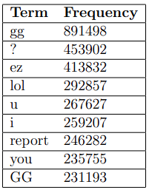
Most Frequent game specific terms
These words are added to updated Bing lexicon.
Top 100 words with respect to count are appended.
Notes:
These are the most frequently used words in gaming envioronemtn . Thay have no specific in normal discourse, but in DOTA 2 some of these terms are often used to convey negative emotions.

Slide 11
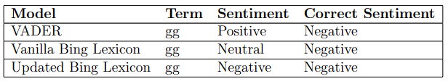
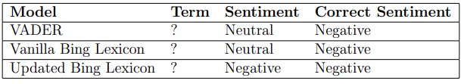
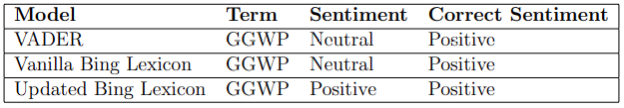
Results
“gg”
“?”
“GGWP”
Notes:
These are the compartive predictions of different models. As can be seen only the updated bing lexicon is able to provide true positives.

Slide 12
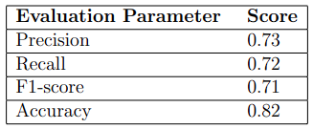
Evaluation
Notes:
These are the evalauation parameters. In practice there is a slight in increase across the spectrum when compared to vanilla bing lexicon

Slide 13
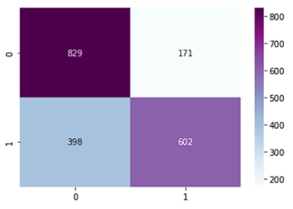
Confusion Matrix
Notes:
This is the confusion matrix for the updated lexicon.

Slide 14
Advantages and limitations
Less false positives with the updated lexicon.
Higher accuracy
Research focus only on English
KDD methodology could have been more appropriate
Limited potential due to limited words updated.
Notes:
We were able to obtain better predictions with the updated lexicon and better accuracy.
The research also only focuses on the English which is highly limits the application scaling of the project. Gaming is very diverse and players from all over the world enjoy.
Using CRISP-DM methodology may not be an appropriate approach to the research question and KDD methodology could have been a proper fit. In a scenario without time constraint, the alternate can be used a proper route to obtain results.
The scope of the project is small due to low number of terms that were updated in the dictionary

Slide 15
Future works
More languages.
More specific terminology
Can be used for generating videogaming specific labeled data
Notes:
The future scope of the project can be increased potentially if multiple language can also be accounted for by the same model. This will also provide as a benchmark for cross platform and cross region server integration and map the human behaviour in such case.
Arranging an updated lexicon will also increase the project potential.

Slide 16
CONCLUSION
Notes:
There is still enough to be done in videogaming sector in terms of human interaction study and the research project will hopefully work in the same direction. Sentiment analysis of in-game Chat to curb cyber-bullying is a step towards eradicating toxicity which highly present in competitive games. A gamer having an enjoyable experience is bound to invest more in the game, hence, the proposed project will be a milestone for videogame developers in keeping track of the players emotions and general toxicity. The proposed project have benefits for all the stakeholders involved in the videogaming sector. Thank you.

Slide 17
THANK YOU

